Slide 1
Chapter 1
Accounting In Action
Financial Accounting, Sixth Edition

Slide 2
Definition of Accounting?
American Institute of Certified Public Accountants (AICPA) has defined Accounting as follows:
“Accounting is the art of recording, classifying, summarizing, in a significant manner and in terms of money, transactions and events which are, in part at least, of a financial character, and interpreting the result thereof.”
SO 1 Explain what accounting is.

Slide 3
What is Accounting?
Accounting consists of three basic activities - it
  identifies,
  records, and
  communicates
  the economic events of an organization to interested users.
LO 1 Explain what accounting is.

Slide 4
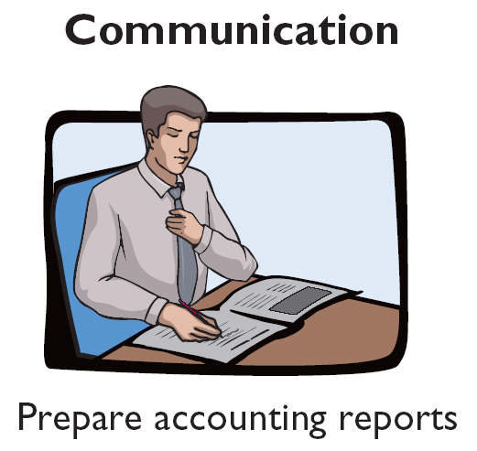
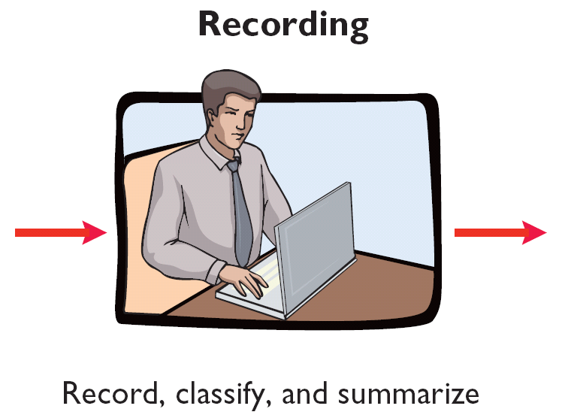
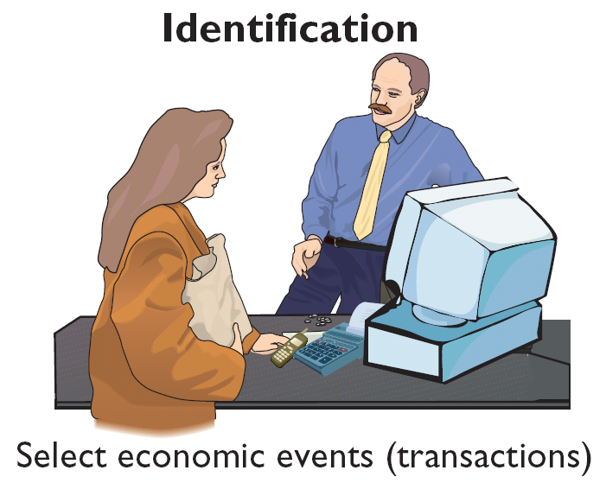
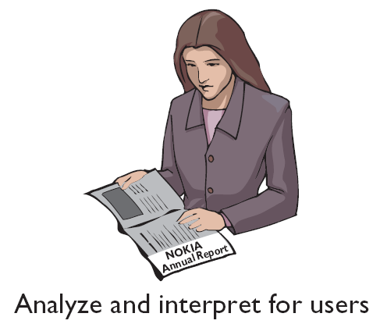
What is Accounting?
Three Activities
Illustration 1-1
Accounting process
The accounting process includes
the bookkeeping function.
SO 1 Explain what accounting is.

Slide 5

Who Uses Accounting Data?
Internal Users
Management
IRS
Human Resources
Investors
Labor Unions
Finance
Creditors
Marketing
SEC
Customers
External Users
SO 2 Identify the users and uses of accounting.

Slide 6
Who Uses Accounting Data?
Common Questions Asked
User
1. Can we afford to give our employees a pay raise?
Human Resources
2. Did the company earn a satisfactory income?
Investors
3. Do we need to borrow in the near future?
Management
4. Is cash sufficient to pay dividends to the stockholders?
Finance
5. What price for our product will maximize net income?
Marketing
6. Will the company be able to pay its short-term debts?
Creditors
SO 2 Identify the users and uses of accounting.

Slide 7

The Building Blocks of Accounting
Financial Statements
Statement of financial position
Income Statement
Retained Earnings Statement
Statement of Cash Flows
Note Disclosure
Various users need financial information
The accounting profession has attempted to develop a set of standards that are generally accepted and universally practiced.
Generally Accepted Accounting Principles (GAAP)
SO 4 Explain generally accepted accounting principles and the cost principle.

Slide 8
GAAP involves principles and assumptions and Accounting Standards which are universally and generally accepted by accountants.
Cost Principle (Historical) – dictates that companies record assets at their cost.
Revenue Recognition Principle – the company should
recognize revenue when it completely provided service or
delivered the product to its customers.
Expense Recognition Principle – The company should
recognize expenses which generate revenue for the same
period.
SO 4 Explain generally accepted accounting principles and the cost principle.

Slide 9

Assumptions
Monetary Unit Assumption – include in the accounting records only transaction data that can be expressed in terms of money.
Economic Entity Assumption – requires that activities of the entity be kept separate and distinct from the activities of its owner and all other economic entities.
  Proprietorship.
  Partnership.
  Corporation.
Forms of Business Ownership
SO 5 Explain the monetary unit assumption and the economic entity assumption.

Slide 10

Forms of Business Ownership
Proprietorship
Partnership
Corporation
Generally owned by one person.
Often small service-type businesses
Owner receives any profits, suffers any losses, and is personally liable for all debts.
Owned by two or more persons.
Often retail and service-type businesses
Generally unlimited personal liability
Partnership agreement
Ownership divided into shares of stock
Separate legal entity organized under state corporation law
Limited liability
SO 5 Explain the monetary unit assumption and the economic entity assumption.
Notes:
Service Cost - Actuaries compute service cost as the present value of the new benefits earned by employees during the year. Future salary levels considered in calculation.
Interest on Liability - Interest accrues each year on the PBO just as it does on any discounted debt.
Actual Return on Plan Assets - Increase in pension funds from interest, dividends, and realized and unrealized changes in the fair market value of the plan assets.
Amortization of Unrecognized Prior Service Cost - The cost of providing retroactive benefits is allocated to pension expense in the future, specifically to the remaining service-years of the affected employees.
Gain or Loss - Volatility in pension expense can be caused by sudden and large changes in the market value of plan assets and by changes in the projected benefit obligation. Two items comprise the gain or loss:
difference between the actual return and the expected return on plan assets and,
amortization of the unrecognized net gain or loss from previous periods

Slide 11
Forms of Business Ownership
Review Question
A business organized as a separate legal entity under state law having ownership divided into shares of stock is a
  proprietorship.
  partnership.
  corporation.
  sole proprietorship.
SO 5 Explain the monetary unit assumption and the economic entity assumption.

Slide 12
Accounting analyzing and recording starts from Accounting Equations

Slide 13
The Basic Accounting Equation
Assets
Liabilities
Stockholders’ Equity
=
+
Provides the underlying framework for recording and summarizing economic events.
Assets
  Resources a business owns.
  Provide future services or benefits.
  Cash, Supplies, Equipment, etc.
SO 6 State the accounting equation, and define assets, liabilities, and stockholders’ equity.

Slide 14
The Basic Accounting Equation
Assets
Liabilities
Stockholders’ Equity
=
+
Provides the underlying framework for recording and summarizing economic events.
Liabilities
  Claims against assets (debts and obligations).
  Creditors - party to whom money is owed.
  Accounts payable, Notes payable, etc.
SO 6 State the accounting equation, and define assets, liabilities, and stockholders’ equity.

Slide 15
The Basic Accounting Equation
Assets
Liabilities
Stockholders’ Equity
=
+
Provides the underlying framework for recording and summarizing economic events.
Stockholders’ Equity
  Ownership claim on total assets.
  Referred to as residual equity.
  Share capital-ordinary and retained earnings.
SO 6 State the accounting equation, and define assets, liabilities, and stockholders’ equity.

Slide 16
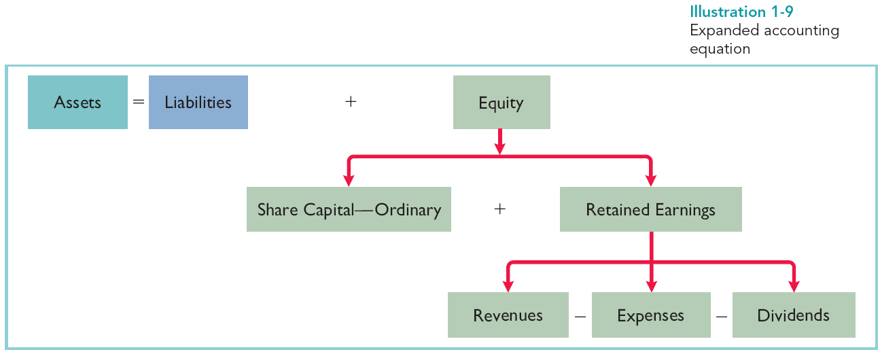
Using the Accounting Equation
Transaction Analysis
Illustration 1-9
Expanded accounting equation
Stockholders’ Equity
Stockholders’ Equity includes Share Capital - Ordinary and Retained Earnings.
Retained Earnings are affected by Revenue, Expense and Dividend. Revenues increase Retained Earnings; Expenses and Dividends decrease Retained Earnings.
LO 7 Analyze the effects of business transactions on the accounting equation.

Slide 17
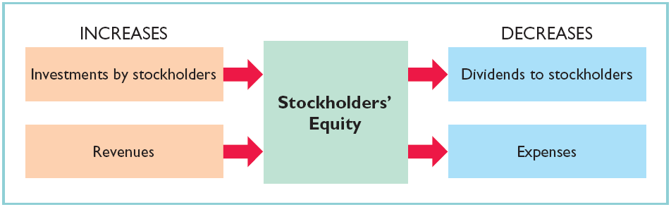
Stockholders’ Equity
Illustration 1-6
SO 6 State the accounting equation, and define assets, liabilities, and stockholders’ equity.

Slide 18
Using The Basic Accounting Equation
Transactions are a business’s economic events recorded by accountants.
  May be external or internal.
  Not all activities represent transactions.
  Each transaction has a dual effect on the accounting equation.
SO 7 Analyze the effects of business transactions on the accounting equation.

Slide 19


Transactions
Question: Are the following events recorded in the accounting records?
Supplies are purchased on account.
An employee is hired.
Dividends are paid to stockholders’.
Event
Criterion
Is the financial position (assets, liabilities, or stockholders’ equity) of the company changed?
Record/ Don’t Record
SO 7 Analyze the effects of business transactions on the accounting equation.

Slide 20
Transactions (Problem)
P1-1A: Barone’s Repair Shop was started on May. Prepare a tabular analysis of the following transactions for the month of May.
1. Stockholders invested $10,000 cash to start the repair shop.
Assets
Liabilities
Stockholders’ Equity
Accounts Receivable
Accounts Payable
Share Capital
Cash
+
+
Equipment
=
+
1.
+10,000
+10,000
Investment
SO 7 Analyze the effects of business transactions on the accounting equation.

Slide 21
Transactions (Problem)
2. Purchased equipment for $5,000 cash.
Assets
Liabilities
Stockholders’ Equity
Accounts Receivable
Accounts Payable
Share Capital
Cash
+
+
Equipment
=
+
1.
+10,000
+10,000
Investment
2.
-5,000
+5,000
SO 7 Analyze the effects of business transactions on the accounting equation.

Slide 22
Transactions (Problem)
3. Paid $400 cash for May office rent.
Assets
Liabilities
Stockholders’ Equity
Accounts Receivable
Accounts Payable
Share Capital
Retained Earnings
Cash
+
+
Equipment
=
+
+
1.
+10,000
+10,000
2.
-5,000
+5,000
3.
-400
-400
Rent Expense
SO 7 Analyze the effects of business transactions on the accounting equation.

Slide 23
Transactions (Problem)
4. Received $5,100 from customers for repair service.
Assets
Liabilities
Stockholders’ Equity
Accounts Receivable
Accounts Payable
Share Capital
Retained Earnings
Cash
+
+
Equipment
=
+
+
1.
+10,000
+10,000
2.
-5,000
+5,000
3.
-400
-400
4.
+5,100
+5,100
Service Revenue
SO 7 Analyze the effects of business transactions on the accounting equation.

Slide 24
Transactions (Problem)
5. Paid dividends of $1,000 cash.
Assets
Liabilities
Stockholders’ Equity
Accounts Receivable
Accounts Payable
Share Capital
Retained Earnings
Cash
+
+
Equipment
=
+
+
1.
+10,000
+10,000
2.
-5,000
+5,000
3.
-400
-400
4.
+5,100
+5,100
5.
-1,000
-1,000
SO 7 Analyze the effects of business transactions on the accounting equation.

Slide 25
Transactions (Problem)
6. Paid part-time employee salaries of $2,000.
Assets
Liabilities
Stockholders’ Equity
Accounts Receivable
Accounts Payable
Share Capital
Retained Earnings
Cash
+
+
Equipment
=
+
+
1.
+10,000
+10,000
2.
-5,000
+5,000
3.
-400
-400
4.
+5,100
+5,100
5.
-1,000
-1,000
6.
-2,000
-2,000
Salary Expense
SO 7 Analyze the effects of business transactions on the accounting equation.

Slide 26
Transactions (Problem)
7. Incurred $250 of advertising costs, on account.
Assets
Liabilities
Stockholders’ Equity
Accounts Receivable
Accounts Payable
Share Capital
Retained Earnings
Cash
+
+
Equipment
=
+
+
1.
+10,000
+10,000
2.
-5,000
+5,000
3.
-400
-400
4.
+5,100
+5,100
5.
-1,000
-1,000
6.
-2,000
-2,000
7.
+250
-250
Advertising Expense
SO 7 Analyze the effects of business transactions on the accounting equation.

Slide 27
Transactions (Problem)
8. Provided repair services on account to customers $750.
Assets
Liabilities
Stockholders’ Equity
Accounts Receivable
Accounts Payable
Share Capital
Retained Earnings
Cash
+
+
Equipment
=
+
+
1.
+10,000
+10,000
2.
-5,000
+5,000
3.
-400
-400
4.
+5,100
+5,100
5.
-1,000
-1,000
6.
-2,000
-2,000
7.
+250
-250
8.
+750
+750
Service Revenue
SO 7 Analyze the effects of business transactions on the accounting equation.

Slide 28
Transactions (Problem)
9. Collected $120 cash for services previously billed.
Assets
Liabilities
Stockholders’ Equity
Accounts Receivable
Accounts Payable
Share Capital
Retained Earnings
Cash
+
+
Equipment
=
+
+
1.
+10,000
+10,000
2.
-5,000
+5,000
3.
-400
-400
4.
+5,100
+5,100
5.
-1,000
-1,000
6.
-2,000
-2,000
7.
+250
-250
8.
+750
+750
9.
+120
-120
6,820 + 630 + 5,000 = 250 + 10,000 + 2,200
SO 7 Analyze the effects of business transactions on the accounting equation.

Slide 29
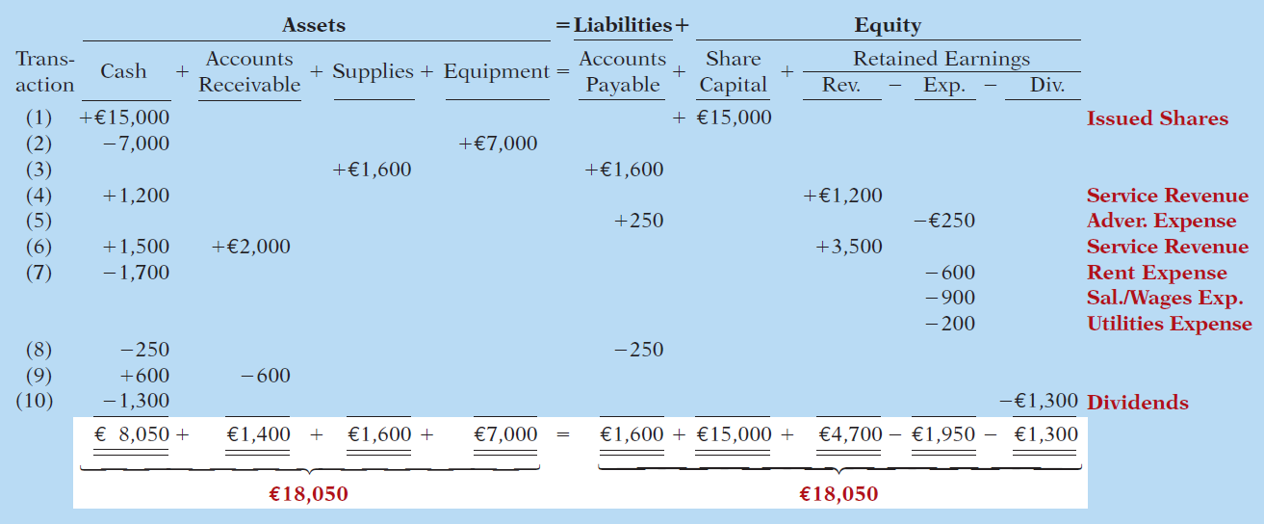
Transaction Analysis
Transaction (1). Investment by Shareholders. Ray and Barbara Neal decides to open a computer programming service which he names Softbyte. On September 1, 2014, they invest €15,000 cash in exchange for €15,000 of ordinary shares.
Illustration 1-10
Stockholders’ Equity
LO 7

Slide 30
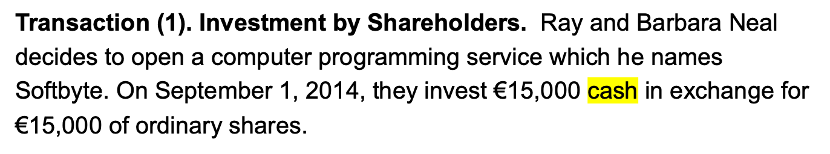
Transaction Analysis
Illustration 1-10
Stockholders’ Equity
LO 7

Slide 31
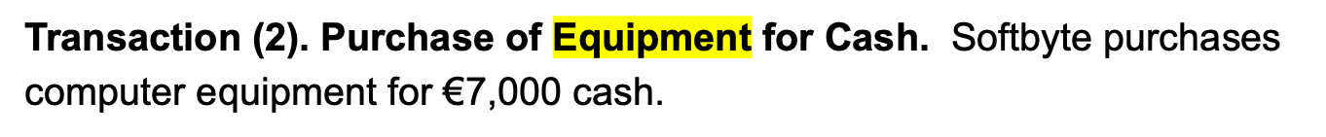
Transaction Analysis
Illustration 1-10
Stockholders’ Equity
LO 7

Slide 32
Transaction Analysis
Illustration 1-10
Stockholders’ Equity
LO 7

Slide 33
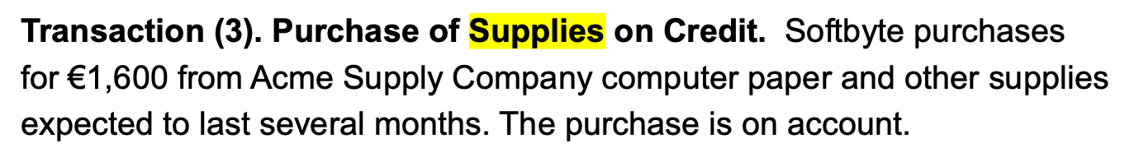
Transaction Analysis
Illustration 1-10
Stockholders’ Equity
LO 7

Slide 34

Transaction Analysis
Illustration 1-10
Stockholders’ Equity
LO 7

Slide 35
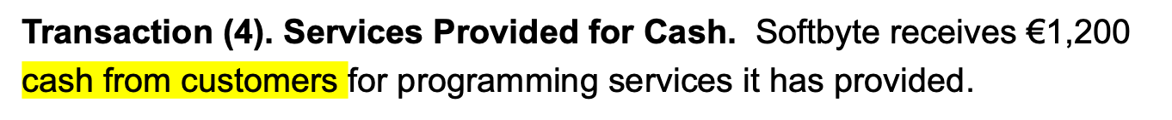
Transaction Analysis
Illustration 1-10
Stockholders’ Equity
LO 7

Slide 36

Transaction Analysis
Illustration 1-10
Stockholders’ Equity
LO 7

Slide 37
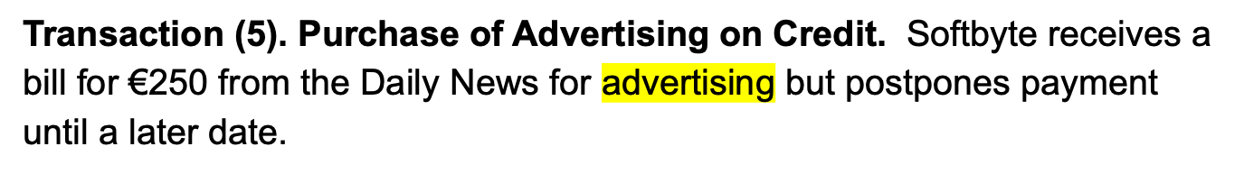
Transaction Analysis
Illustration 1-10
Stockholders’ Equity
LO 7

Slide 38

Transaction Analysis
Illustration 1-10
Stockholders’ Equity
LO 7

Slide 39
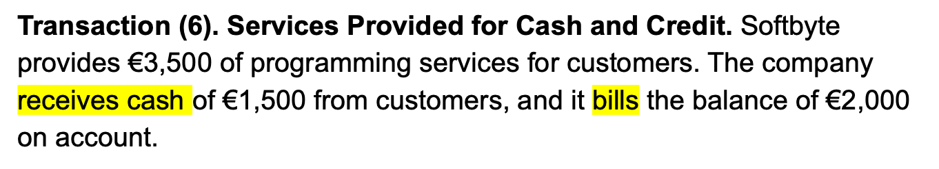
Transaction Analysis
Illustration 1-10
Stockholders’ Equity
LO 7

Slide 40
Transaction Analysis
Illustration 1-10
Stockholders’ Equity
LO 7

Slide 41
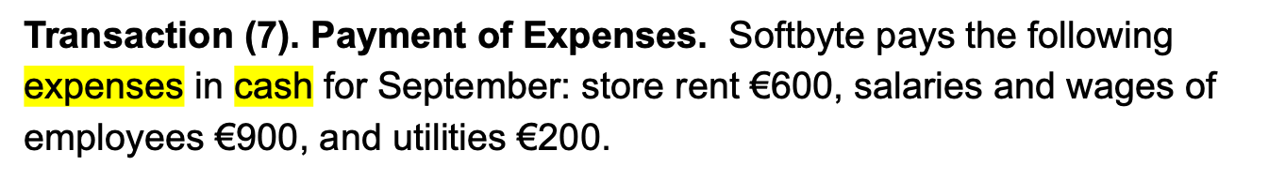
Transaction Analysis
Illustration 1-10
Stockholders’ Equity
LO 7

Slide 42

Transaction Analysis
Illustration 1-10
Stockholders’ Equity
LO 7

Slide 43

Transaction Analysis
Illustration 1-10
Stockholders’ Equity
LO 7

Slide 44

Transaction Analysis
Illustration 1-10
Stockholders’ Equity
LO 7

Slide 45
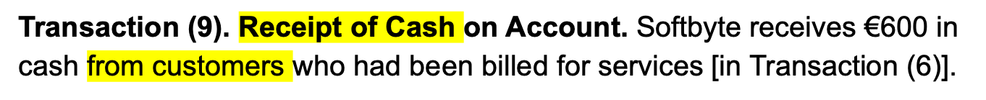
Transaction Analysis
Illustration 1-10
Stockholders’ Equity
LO 7

Slide 46
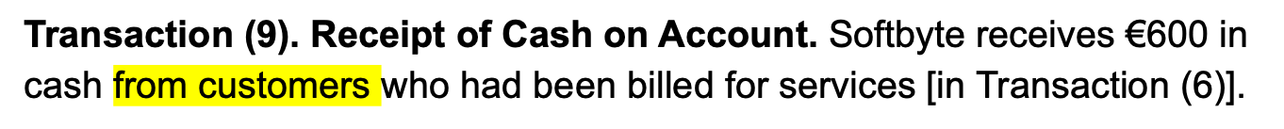
Transaction Analysis
Illustration 1-10
Stockholders’ Equity
LO 7

Slide 47
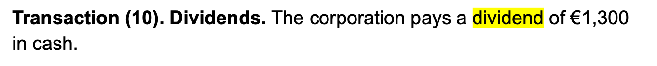
Transaction Analysis
Illustration 1-10
Stockholders’ Equity
LO 7

Slide 48
Transaction Analysis
Illustration 1-10
Stockholders’ Equity
LO 7

Slide 49
Financial Statements
Companies prepare four financial statements :
Income Statement
Retained Earnings Statement
Statement of Financial Position
Statement of Cash Flows
LO 8 Understand the four financial statements and how they are prepared.

